Slide 1
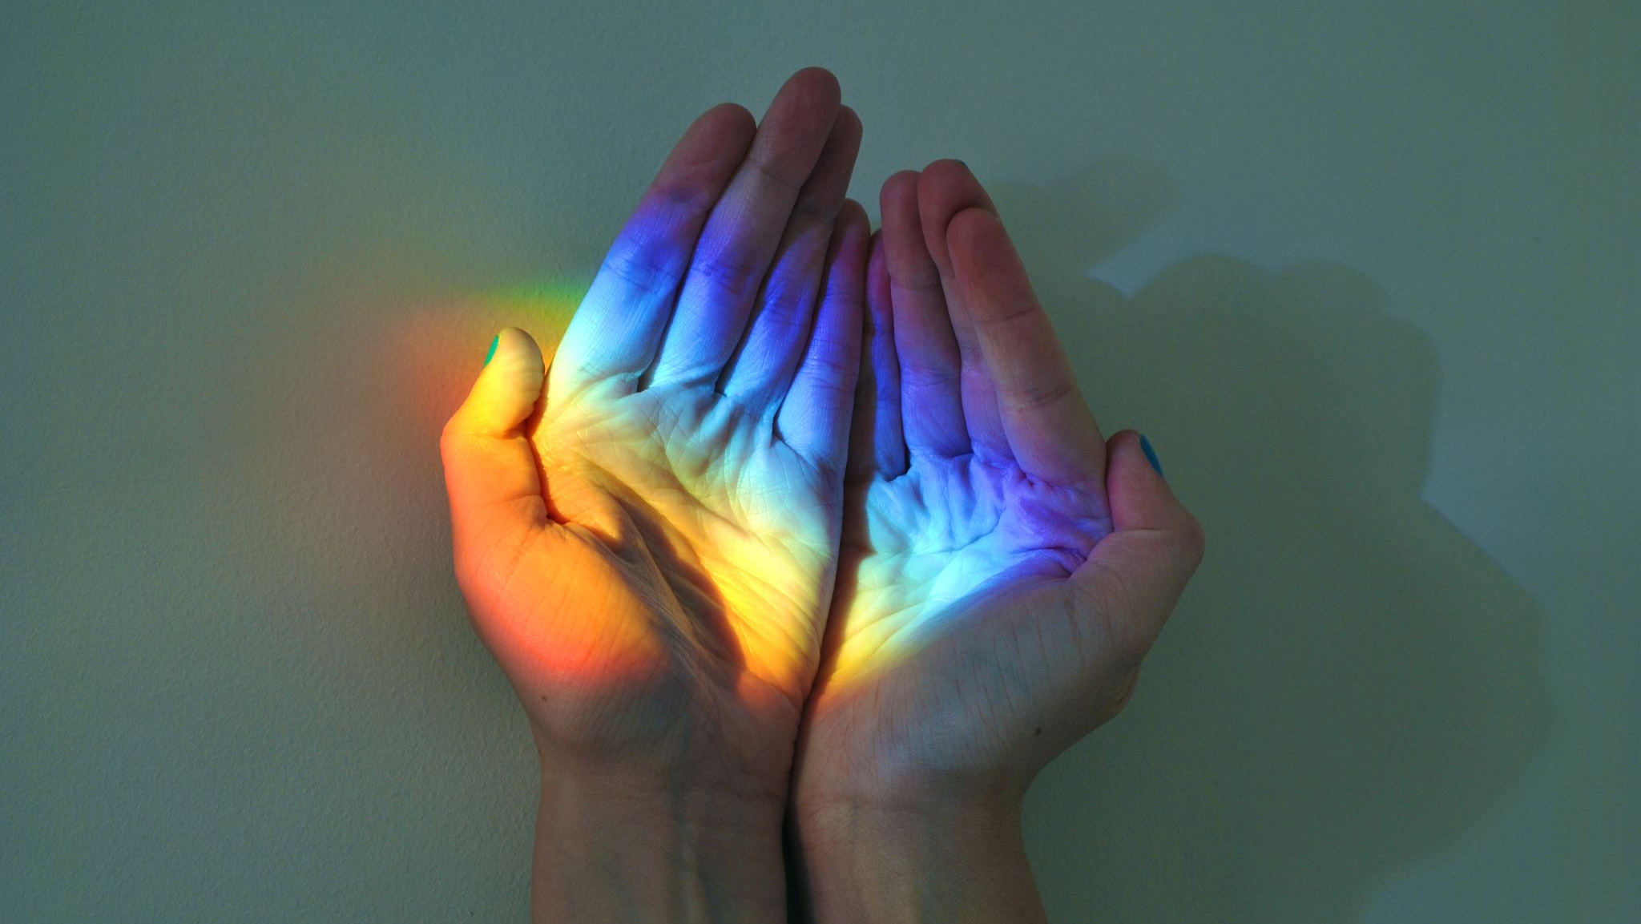
Wh-questions Unit 8 – Jobs
Prof. Msc. Carlos Alberto Gonçalves

Slide 2
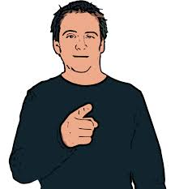

1.Where do you work? 2. What do you do? 3. How do you like it?
Workplace
Job / Profession
Love – hate
I work at Fatec Jales.
I am a Professor.
I love it very much.

Slide 3
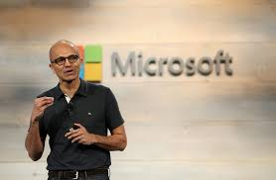
1. Where does John work? 2. What does he do? 3. How does he like it?
John Baker
He works at Microsoft.
He is programmer.
He likes it very much.

Slide 4
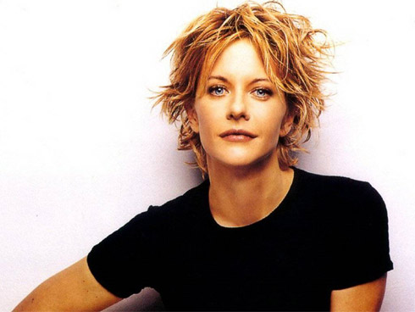
1. Where does Megg work? 2. What does she do? 3. How does she like it?
Megg Ryan
She works at Universal Studios.
She is a movie star.
She likes it.

Slide 5
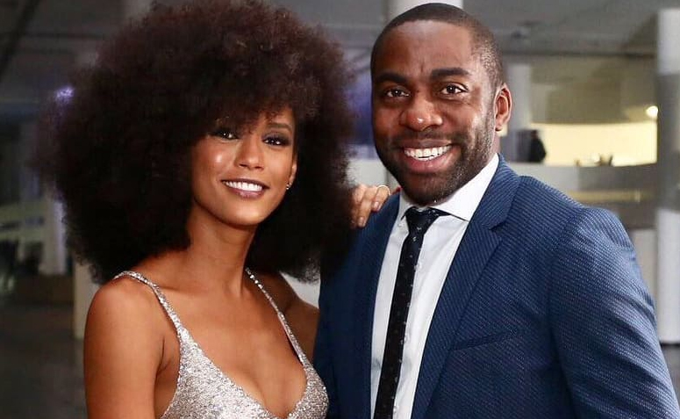
1. Where do Lázaro and Taís work? 2. What do they do? 3. How do they like it?
Lázaro Ramos e Taís Araújo
They work at Globo.
They are actors.
They just love it.

Slide 6
And you?
Where do you work?
What do you do?
How do you like it?
How about your best friend?
Where does he/she work?
What does he/she do?
How does he/she like it?
And your parents?

Slide 7


